Slide 1
A-a-week-8

Slide 2
## Assessment Structure
- 1 hour, 40 minutes
- Mixture of multiple choice (15-20), free response (1-3) and VSCode (1-3) problems, each with multiple specs.
- Free response just requires enough detail to answer the question, 1-3 sentences. As long as you are able to explain the concept and answer all aspects that it asks, you are good.
- Coding problems will have specs to run (`npm test`) and check your work against
- Standard assessment procedures
- You will be in an individual breakout room
- Use a single monitor and share your screen
- Only have open those resources needed to complete the assessment:
- Zoom
- VSCode
- Browser with AAO and Progress Tracker (to ask questions)
- Approved Resources for this assessment:
- MDN: https:>developer.mozilla.org/en-US/docs/Web/JavaScript
the study guide - Anki cards & Code Implementations
BFS & DFS for a graph
BFS & DFS for a binary search tree
know the difference between BF(S/T) and DF(S/T) - search vs traversal

Slide 3
IP Suite
Identify the correct fields of an IPv6 header.
Compared to IPv4's 14 (yikes!) header fields, we now only use 8 fields. They are all listed here, but the main things to be familiar with are the version to indicate IPv4 vs IPv6, as well as the source and destination IP address fields:
Version: Just like IPv4, the first four bits of our packet header represent our version number, which is 0110, representing our decimal 6.
Traffic Class: Identifies the type of packet data
Flow Label: Adds packet sequencing to IP, but is experimental
Payload Length: Specifiies the size of this packet
Next Header: Typically identifies the Transport Layer protocol (TCP, UDP, etc.). It can also indicate an extension header is present, where extra options for the packet are specified (similar concept to the Options field of IPv4, but a different, chainable implementation)
Hop Limit: Decremented by one each time this packet passes through an intermediary. Prevents the packet from being passed around forever.
Source IP Address
Destination IP Address

Slide 4
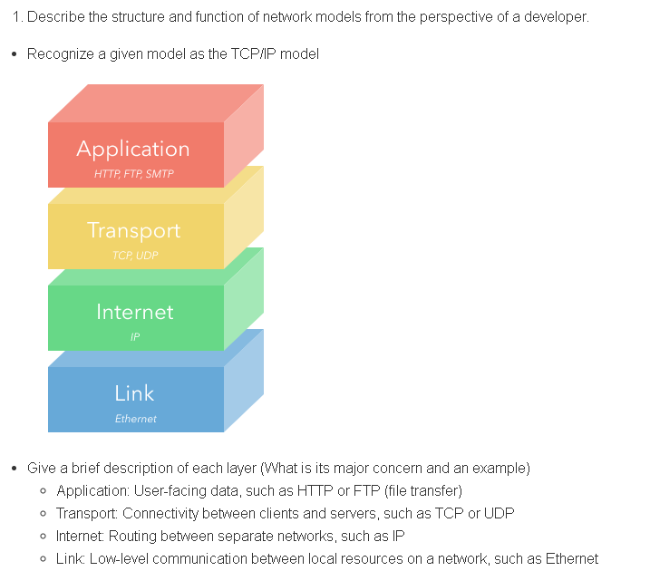
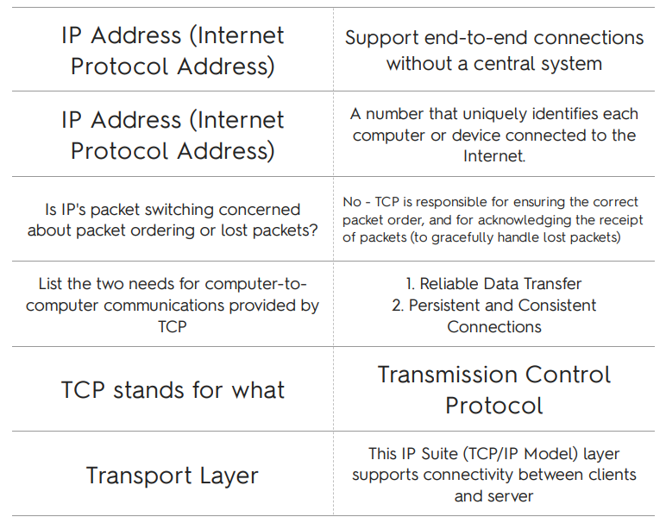
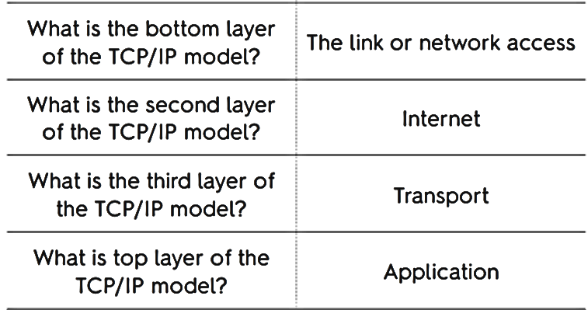

Slide 5
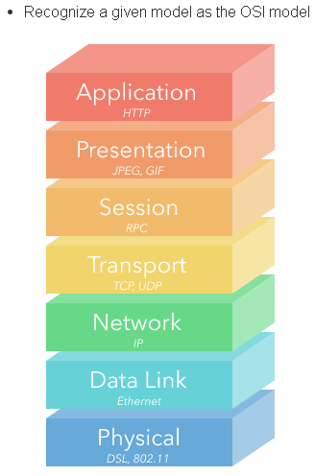
NETWORK OSI
Give a brief description of each layer (What is its major concern and an example)
Application (Layer 7)
Example: HTTP
Information used by client-side software
Presentation (Layer 6)
Example: JPEG, GIF
Data gets translated into a presentable format
Often called the syntax layer since it translates machine-readable syntax into human-readable syntax
Session (Layer 5)
Example: RPC (Remote Procedure Call)
Authentication and data continuity
Authorize actions, reestablish session from dropped connections
Transport (Layer 4)
Example: TCP, UDP
Mirrors TCP/IP's Transport Layer
Focused on data integrity and connectivity
Network (Layer 3)
Example: IP
Mirrors TCP/IP's Internet Layer
Manages connections between different remote networks
Data Link (Layer 2)
Example: Ethernet
Connections between one network interface to another
Primarily used by machines in a local network (ie targeting different MAC addresses)
Physical (Layer 1)
Example: DSL, 802.11 (Wi-Fi)
Translating from electrical signals to bits of data

Slide 6
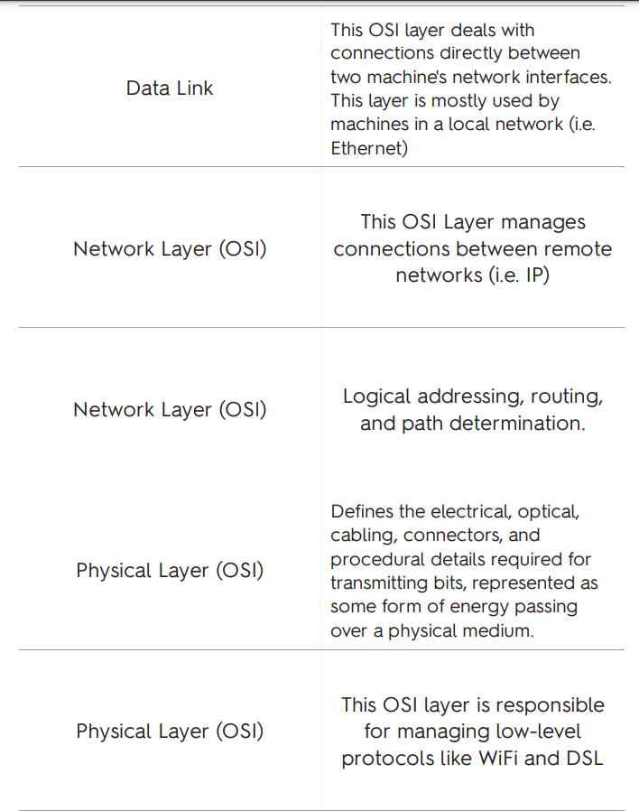
Network OSI

Slide 7
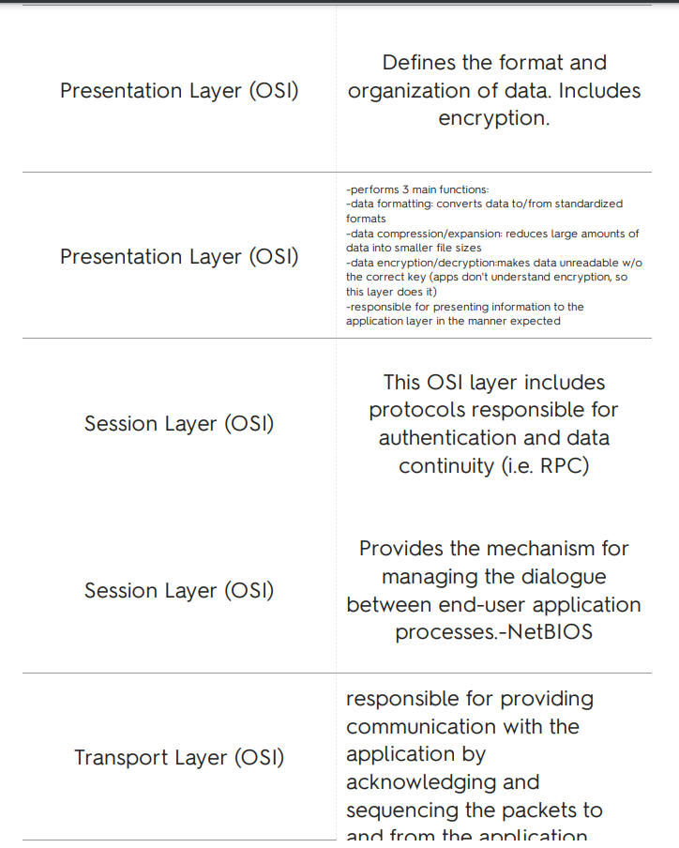
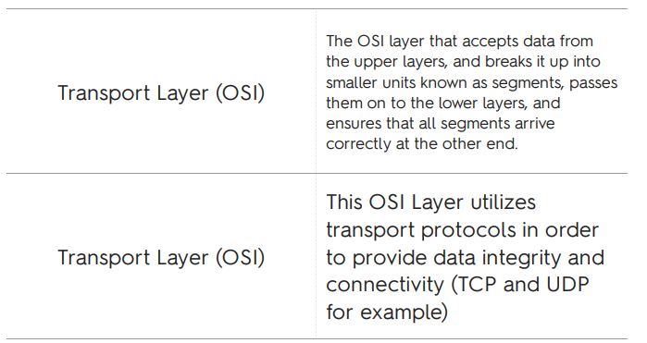

Slide 8
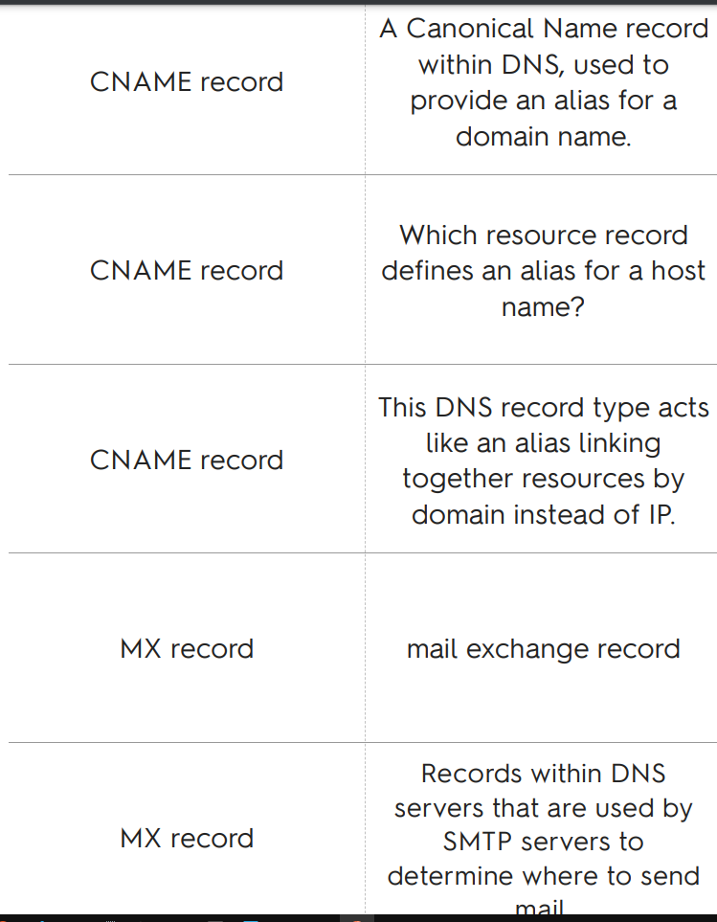
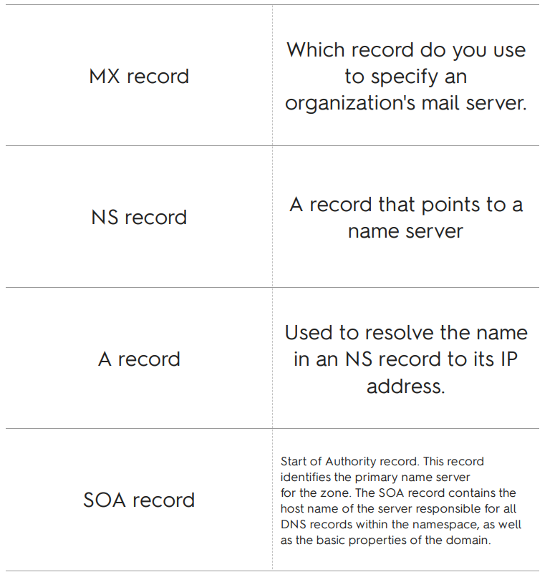
NETWORK DNS

Slide 9
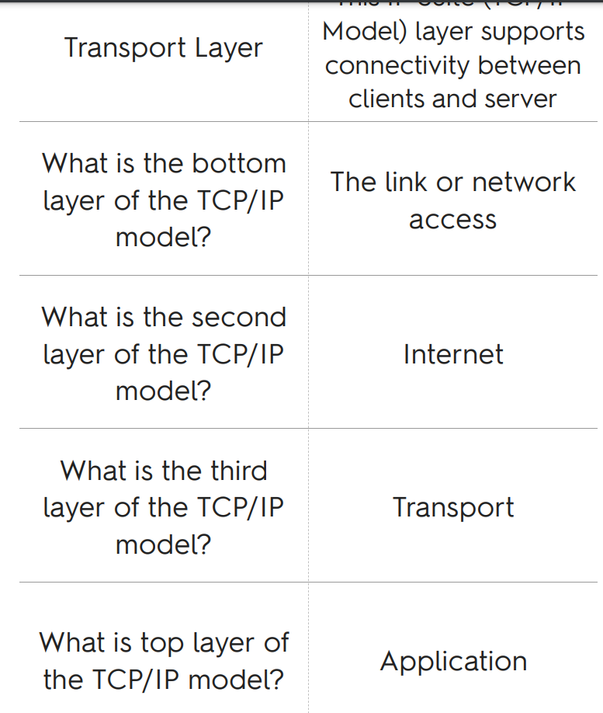
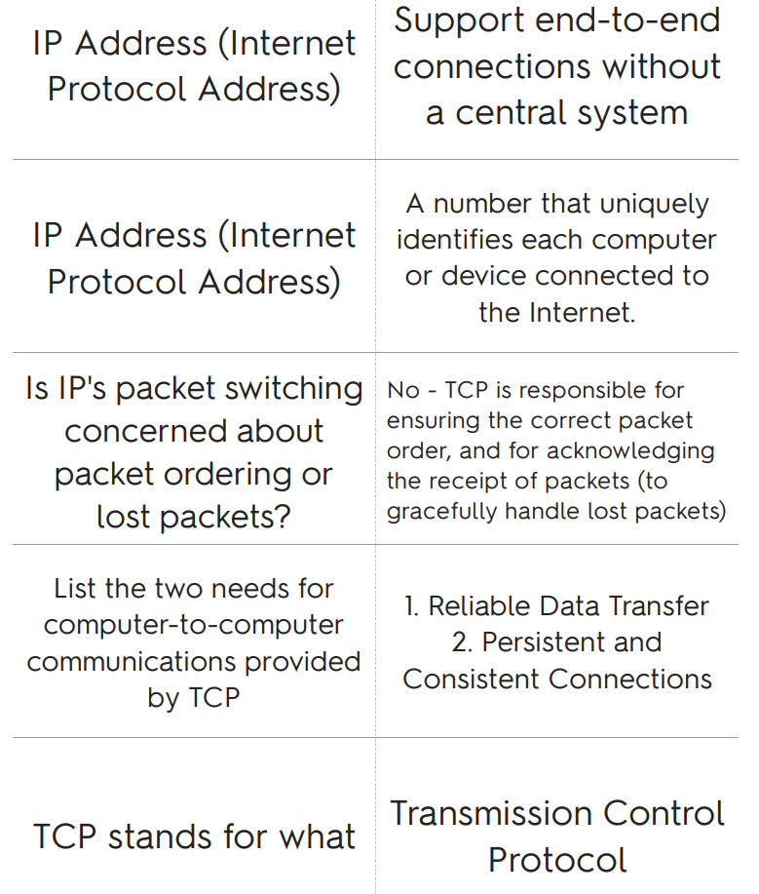
Network TC/IP

Slide 10
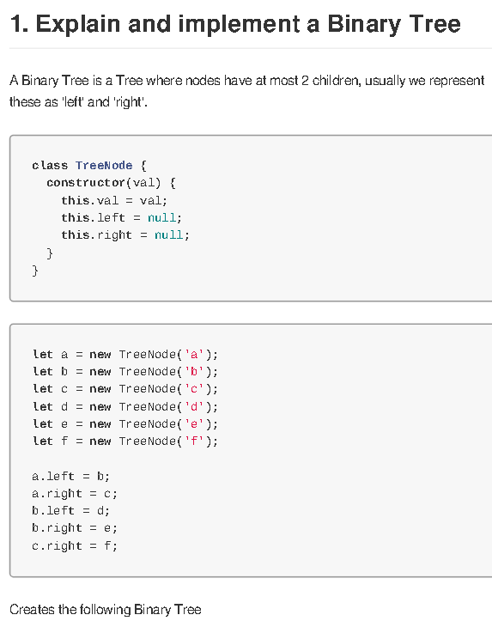
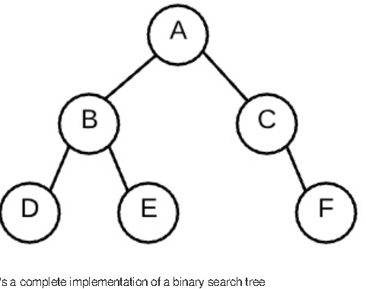
Vocab Binary Tree
Term | Definition
Tree | graph with no cycles
Binary tree | a tree where each node has at most 2 child nodes.
root | the ultimate parent, the single node of a tree that can access every other node through edges; by definition the root will not have a parent
Internal node | a node that has children
Leaf | a node that does not have any children
path | a series of nodes that can be traveled through edges.

Slide 11
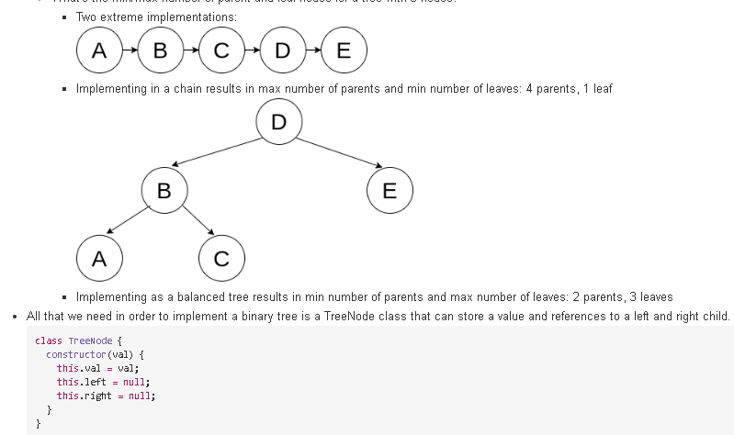
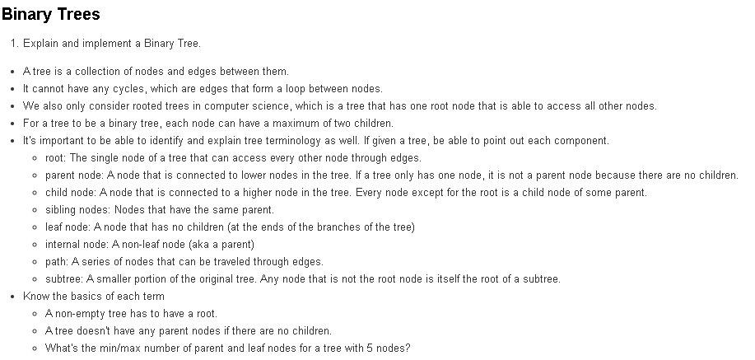

Slide 12
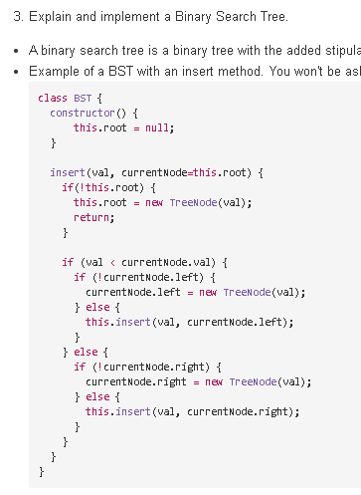
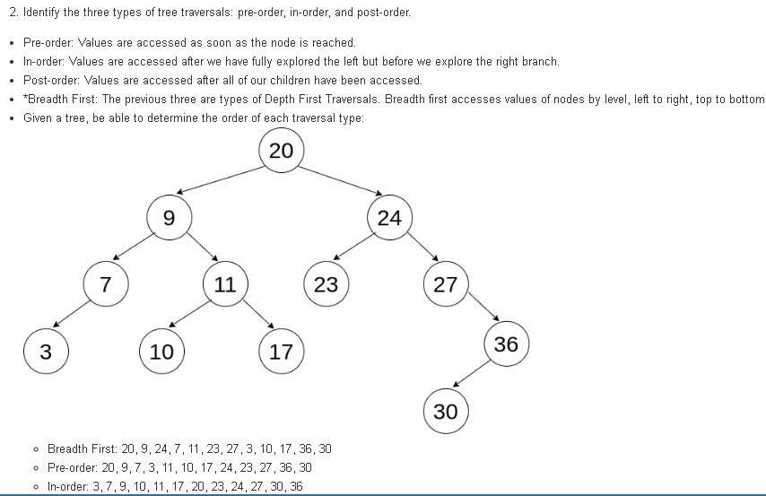

Slide 13
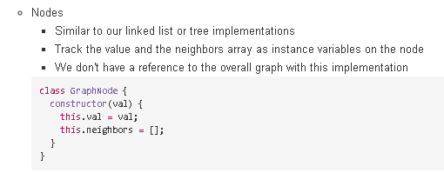
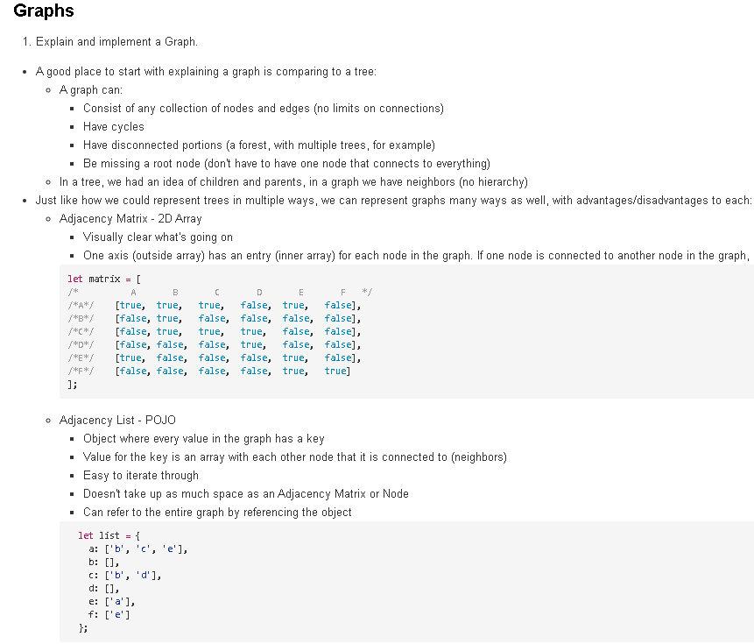
Traverse a graph. We can use recursion or iteration to traverse each node. We generally want to keep track of each node that we've visited already so that we don't get trapped in cycles. Easiest way to do this is to keep a Set variable that we update as we traverse to each node. The projects from W08D03 and their solutions are a great resource here. Be comfortable with taking either an iterative or a recursive approach to traversing a graph, as well as being able to work with either an adjacency list (like in the friendsOf problem) or a node class (like in the breadthFirstSearch or
maxValue problems). Practice taking the implementation that you did in the project and converting it to a different implementation. You probably used recursion for friendsOf, so try using iteration with a stack array, etc. THE INTENTION OF ALL OF THESE CODE BLOCKS IS NOT TO MEMORIZE THEM! You should be comfortable with reasoning out why we are implementing them differently. The main difference between a node implementation and an adjacency list is that we are accessing the node's neighbors attribute just like we are accessing the values on the list (ie, with an adjacency list saved to a graph variable, graph[node] gives all of node's neighbors). The main difference between a depth-first and breadth-first is utilizing a stack vs a queue. Nodes and other objects will have their value accessed using . notation or [] notation. the same is not true if the data set you are working with contains strings or numbers. their 'value' is just the string/number itself (not accessed via .val). Some possible example implementations (note: the solution to the adjacency list problem from the LOs-empty is in here with some minor tweaking) Using a NODE implementation with RECURSION:

Slide 14
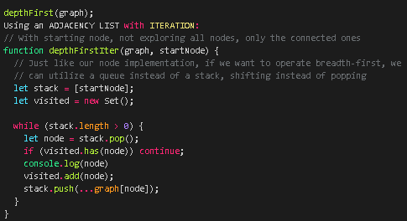
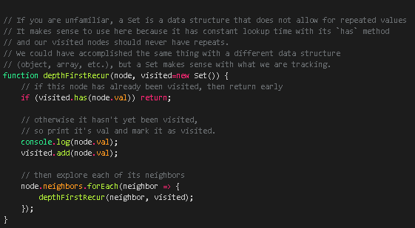
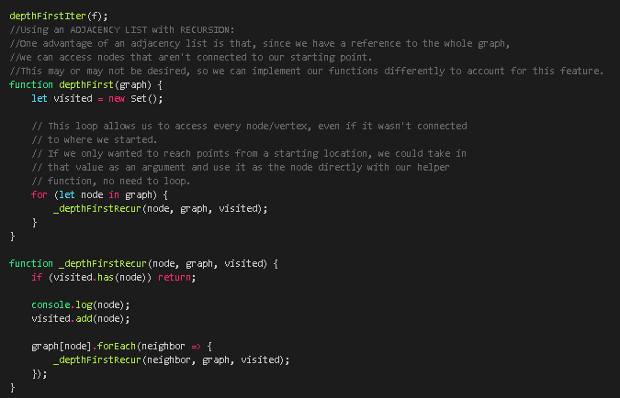
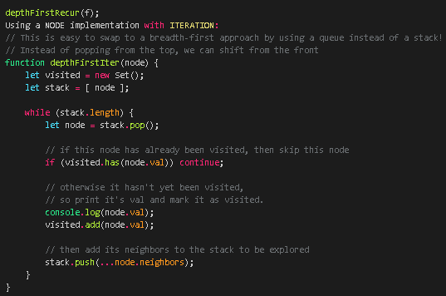

Slide 15
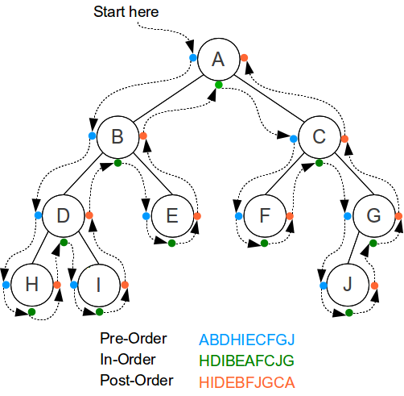
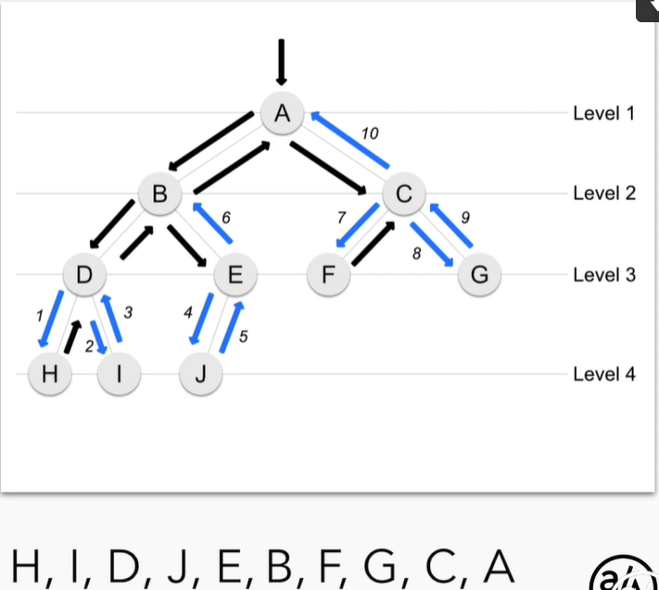
Depth First Search
These are all depth first traversals, which means using recursion.
When doing a "Depth-first search" (DFS):
the search tree is deepened as much as possible on each child before going to the next sibling.
-----------------------------------------------------------------------------------------
There are three common ways to traverse them in depth-first order: in-order, pre-order and post-order.
InOrder:
‣1: Recursively visit the left sub tree
‣2: Access the data of the current node
‣3: Recursively visit the right sub tree
PreOrder:
‣1: Access the data of the current node
‣2: Recursively visit the left sub tree
‣3: Recursively visit the right sub tree
PostOrder:
‣1: Recursively visit the left sub tree
‣2: Recursively visit the right sub tree
‣3: Access the data of the current node
PostOrder:

Slide 16
Breadth First Search
Breadth-first Search on the adjacency list graph. When doing breadth first, iterative is simpler and easier. We can use a queue to do this.

Slide 17
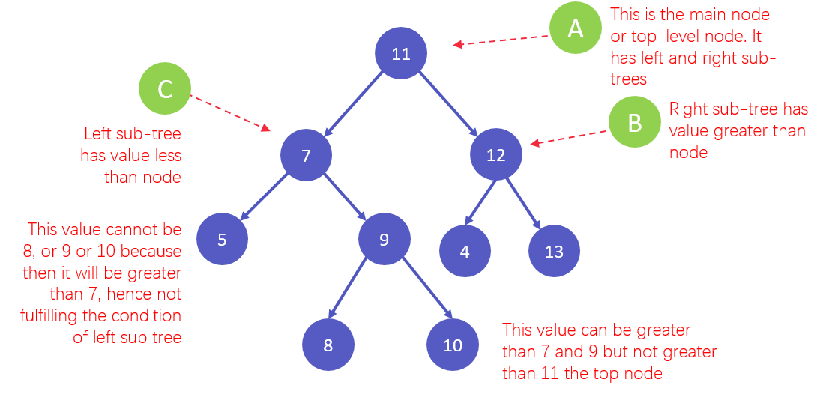
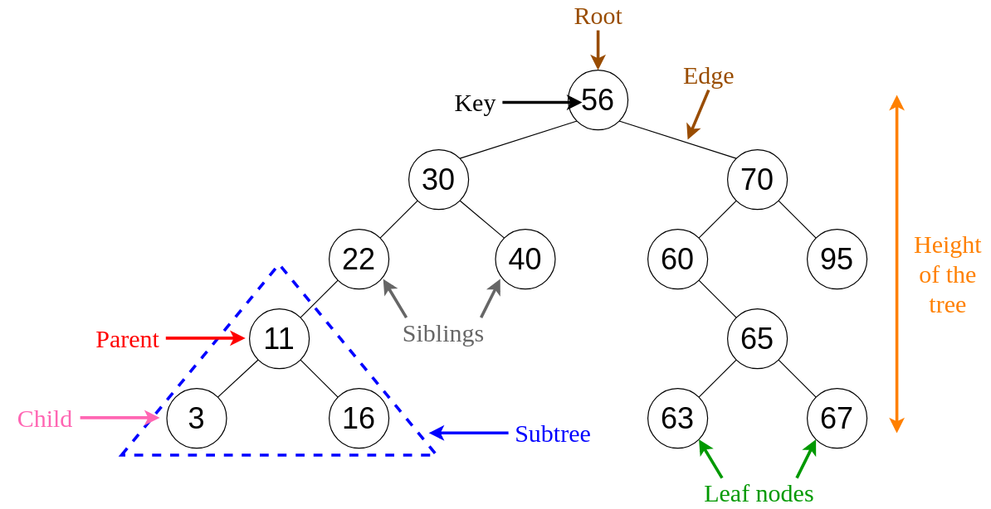
Vocab Binary Search Tree
Binary Search Tree if:
the left subtree contains values less than the root AND
the right subtree contains values greater than or equal to the root AND
the left subtree is a Binary Search Tree AND
the right subtree is a Binary Search Tree

Slide 18
Explain and implement a Binary Search Tree
A Binary Search Tree is a special kind of Binary Tree where the following is true:
given any node of the tree, the values in the left subtree must all be strictly less than the given node's value.
and the values in the right subtree must all be greater than or equal to the given node's value
Or to say it with recursion: the left subtree contains values less than the root
AND the right subtree contains values greater than or equal to the root
AND the left subtree is a Binary Search Tree
AND the right subtree is a Binary Search Tree
Some definitions of binary search trees allow duplicates and some do not. We can write our code to deal with the duplicates though.

Slide 19
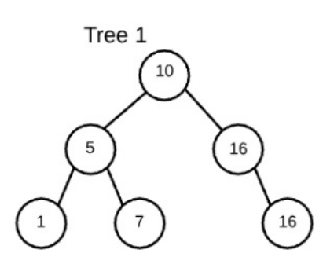
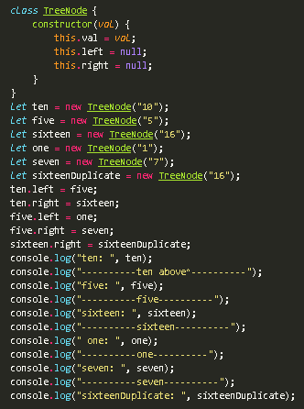
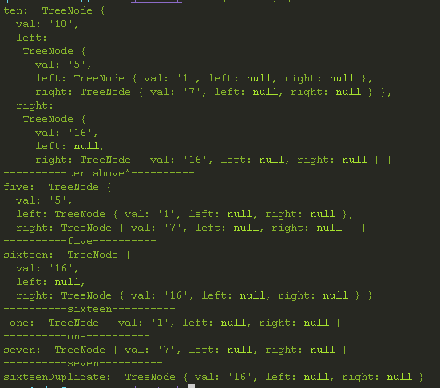

Slide 20
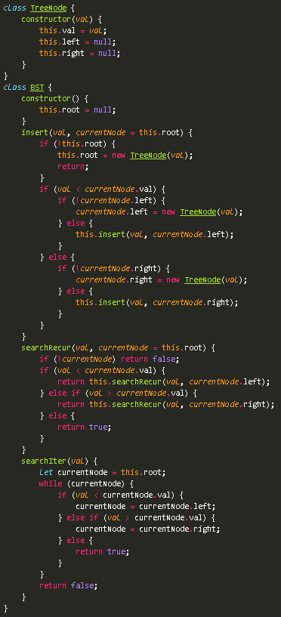
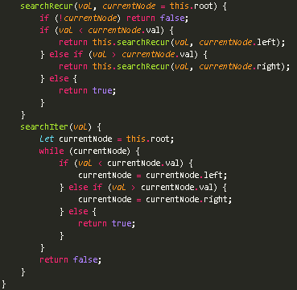
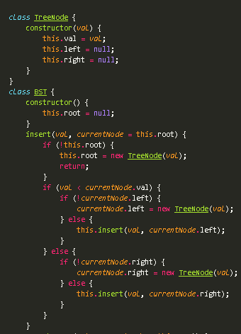
BST Implementation

Slide 21
Graph
A graph is any collection of nodes and edges.
It doesn't need to have a root node (not every node needs to be accessible from a single node)
It can have cycles (a group of nodes whose paths begin and end at the same node)
Cycles are not always "isolated", they can be one part of a larger graph.
You can detect them by starting your search on a specific node
and finding a path that takes you back to that same node.
Any number of edges may leave a given node
A Path is a sequence of nodes on a graph

Slide 22
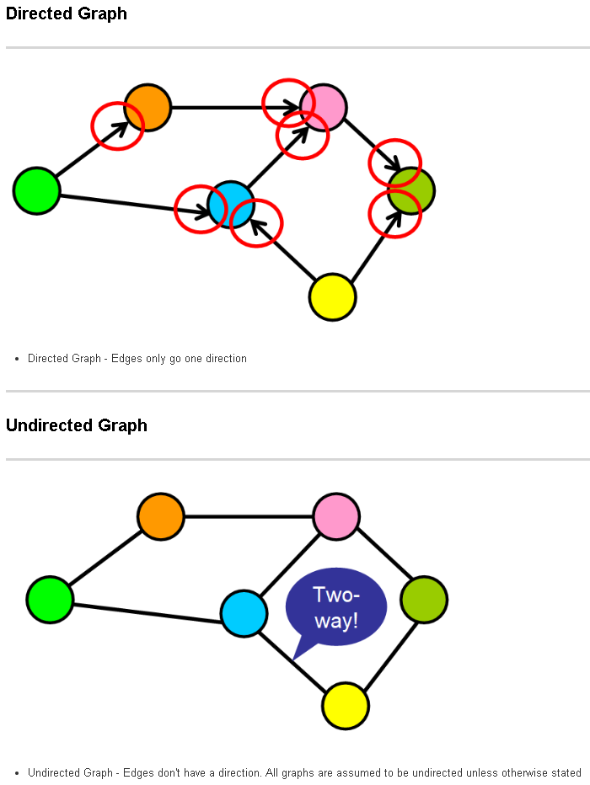
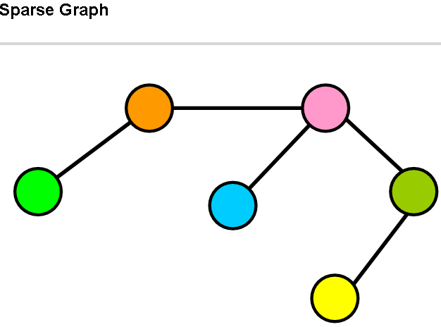
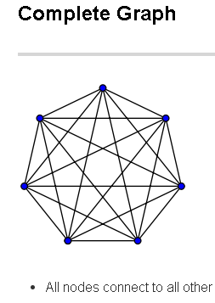
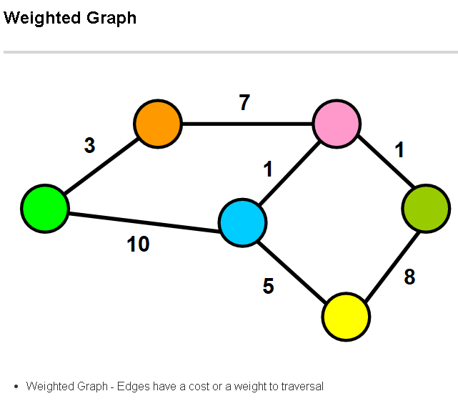
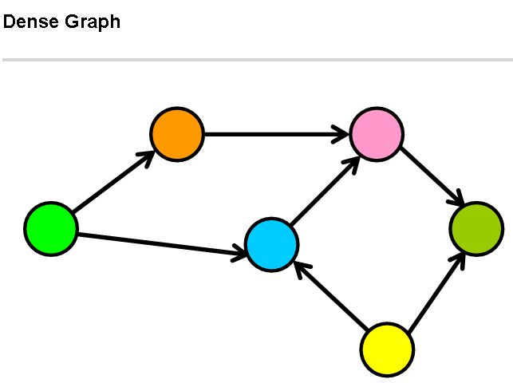
Graph
Directed Graph - Edges only go one direction
Sparse Graph - Few edges
When the number of edges in the graph is significantly fewer than the maximum number of edges, the graph is sparse.
When the number of edges in the graph is close to the maximum number of edges, the graph is dense.
Undirected Graph - Edges don't have a direction. All graphs are assumed to be undirected unless otherwise stated

Slide 23
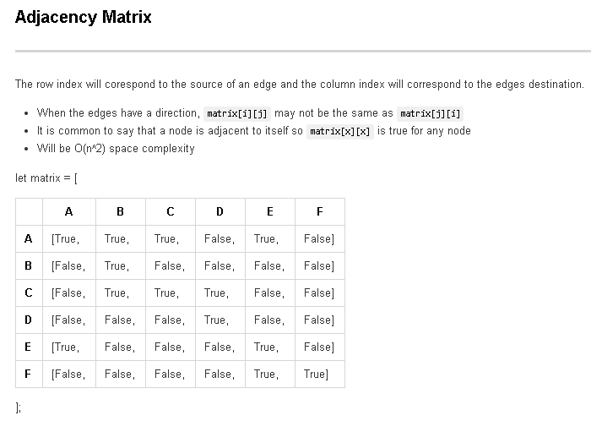
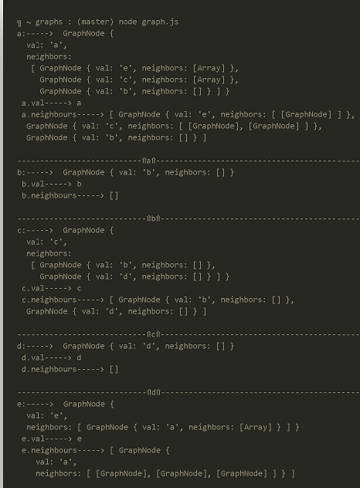
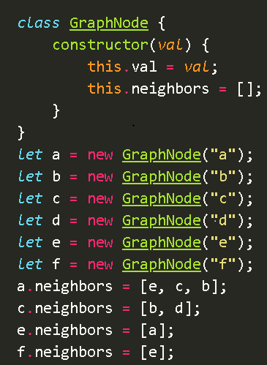
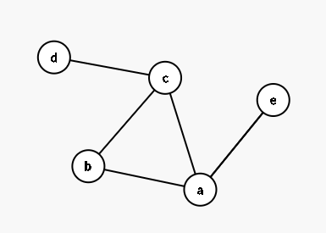
Ways to Reference Graph Nodes
Adjacency List:
> Adjacency List
We use an object where keys represent the node labels.
The values associated with the keys will be an array containing all adjacent nodes,
ie, the nodes which this instance (represented by a key) should hold reference to.
An adjacency list is easy to implement and allows us to refer to the entire graph by simply referencing the object.
> The space required for an adjacency list is the number of edges in the graph.

Slide 24
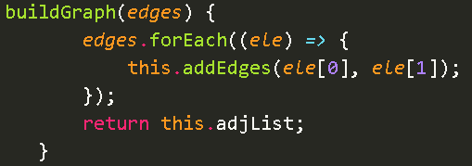
Basic-Graph-Class

Slide 25
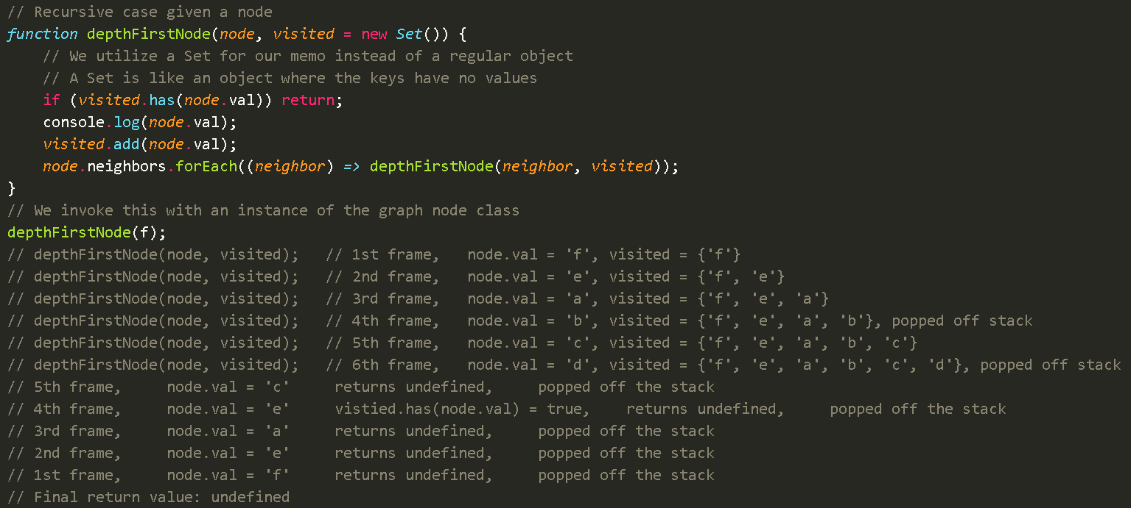
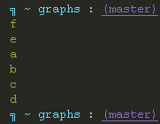
Implement-graph

Slide 26
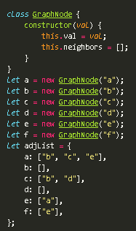
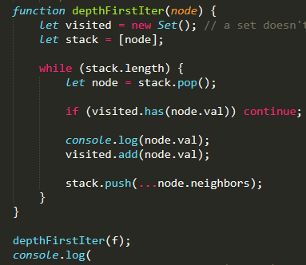
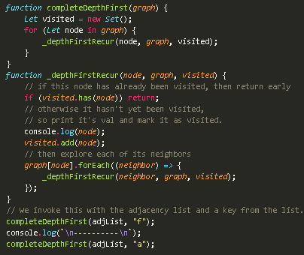
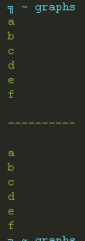
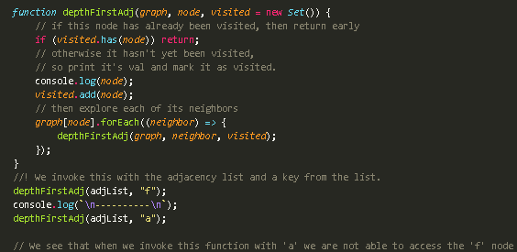

Slide 27
Playground

Slide 28
Playground Testing

Slide 29
Projects: #1

Slide 30
Project 1-leetcode 105

Slide 31
Project 2 BST

Slide 32
Proj-2-leetcode-108

Slide 33
Proj-2-leetcode-110

Slide 34
Proj-2-leetcode-450

Slide 35
Project 3 -1

Slide 36
WHITE BOARDING PROBLEMS 1:

Slide 37
WHITE BOARDING PROBLEMS 2:

Slide 38
WHITE BOARDING PROBLEMS 2:

Slide 39
WHITE BOARDING PROBLEMS 3:

Slide 40
WHITE BOARDING PROBLEMS 4:

Slide 41
PlayGround 2

Slide 42
Friends-Of

